Slide 1
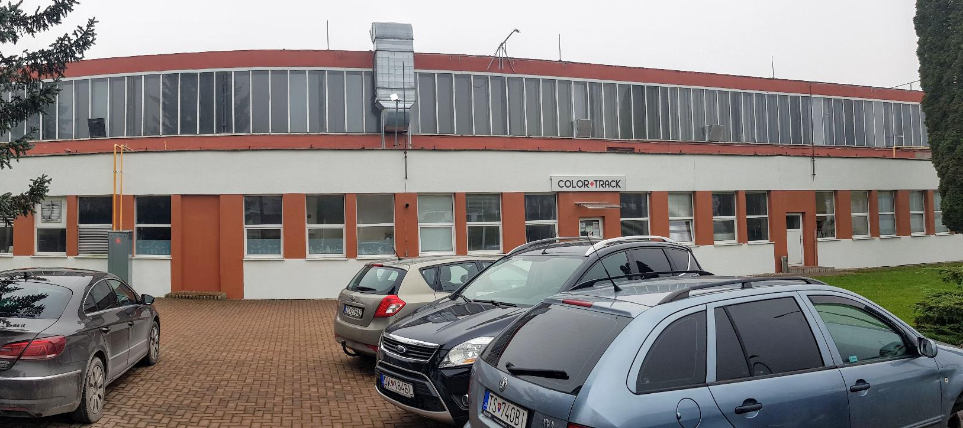
Color track, s.r.o.
01/06/2021

Slide 2
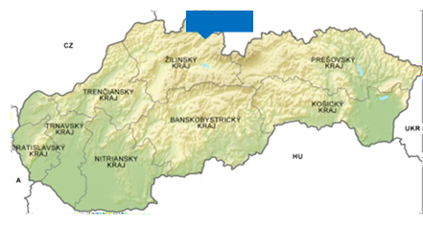
Location
Color track
Location of Color track, s.r.o., Nižná
- Slovakia, region Orava, city of Nizna
- Europe, in between PL-CZ-A-H-UA
Production plant:
M1 Industrial & Logistic Park
Závodná 459
027 43 Nižná
Slovakia
The nearest airports from Color track:
-to A, Wien... 365 km
-to PL, Krakow... 117 km
-to CZ, Ostrava ... 162 km
-to H, Budapest... 294 km
GPS 49.311346, 19.532513

Slide 3
About us
Color track s.r.o. is the successor of Permacoat Slovakia s.r.o, which has been a major player on the painting market in Slovakia since 2016.
2016 – starting painting activities as Permacoat
2/2020 – founding of Color track s.r.o
4/2020 – obtaining ISO 9001-2015 as Color track

Slide 4
Mission & Vision
Our Vision
Our Mission
Our aim is to be a modern, prosperous, stable and credible company for our business partners and employees, with the
growing position on the market for painting technology.
Our mission is to paint products for our customers, to meet their quality specifications and delivery time requirements, provide advice and technical support.

Slide 5
Strategy
Increasing customer satisfaction by having focused action plans.
Motivate our employees, customer focus and team approach.
Realise a positive financial result by continuously improving the competitiveness of our organisation.
Realise a sustainable growth in line with the Business plan.
Become a technology centre for decorative products.
Develop a nonautomotive business.

Slide 6
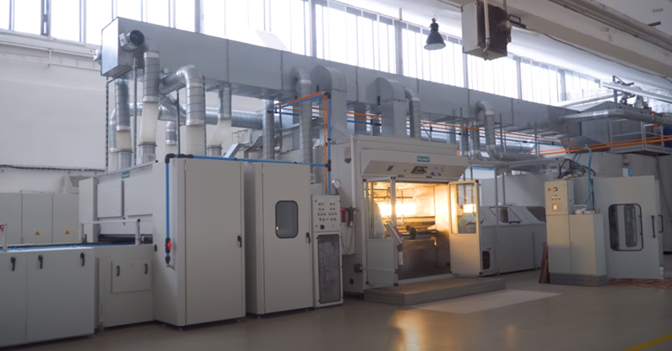
Main Scope
Spraying technology – Venjakob line
Visual control income, outcome parts
Assembly line
Projects cooperation with our partners
working 5 days/week – we are able to increase by double capacity to 4 shift pattern (24/7)
employed avg. 20 people – for better flexibility we can use agency (valid contract)
1.558 m² premises for connected operations with option to increase it by additional 700 m²
turnover app. 1 mil. Eur
placed at industrial park M1 (over 25 000 m2)
key staff on place with many years experiences from automotive production, spraying and plastic production

Slide 7
Production Plant
Premises Potential
660 m2 premises for connected operations.
Space divisions: entry warehouse, parts preparation, line manipulation space, quality control, packaging, expedition warehouse.
Painting line was put into operation in October 2016.
Moulded parts provided by local suppliers or customers.
Team
Technology and its service fulfil last strict norms and requirements.
Key staff on place with many years experiences from automotive production - different painting technologies as well as with same technology and quality requirements.

Slide 8
Painting line
Painting line
Primary developed for automotive plastic parts painting.
Technologicaly able to paint plastics (ABS, PP, PS, PA, PE, HDPE,..).
Console allows setup 100 different settings and programs.
Loading/Reloading Part
Effective palets dimension : 1800 x 800 mm
Number of palets in the line at the same time: 103
Speed of the beds : 0,5 – 2,0 m/min.
The beginning and end of the process in the same place.

Slide 9
Painting line
Humiditer in aircondition area
Ensures the required humidity content.
Preparation of incoming air to the spraying area
(20-25°C and humidity 50-65%) independent of outdoor weather conditions.
Compressor unit with pressure can and drying unit
Compressor–Atlas Copco set-up including compressor with frequency convertor, absorption drying unit with cooling box ( guaranted- 40 C °, ≤ 0,1 mg/m³ of oil in air )

Slide 10
250 m2 of warehouse place designed on:
Receipt of goods
Incoming control of these goods
In-house transport (between different sides of the warehouse)
Expedition of goods
External stock available + 400 m2
Warehouse
We are using drive in racking system
Dynamic warehouse
Drive-in racking is designed for the storage of homogenous products. It
accommodates a several number of pallets for each storage item.

Slide 11
Certification & test tools
EN ISO 9001:2015 Quality management
The byko-test 8500
Gloss meter MG268-F2
TQC Cross Cut Adhesion
Lux Meter PCE-172

Slide 12
Turnover
Year 2020 - 100% Automotive

Slide 13
Our goals in the future
2021
Company website
Certificate of ISO 14001
New Key Account customer
2022
Warehouse management system
Certificate of IATF 16949
New Key Account customer
Project for new technology

Slide 14
Customers
Direct customers
OEM

Slide 15
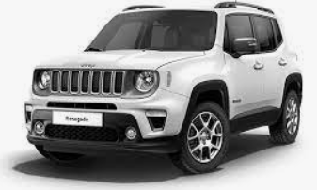
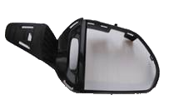
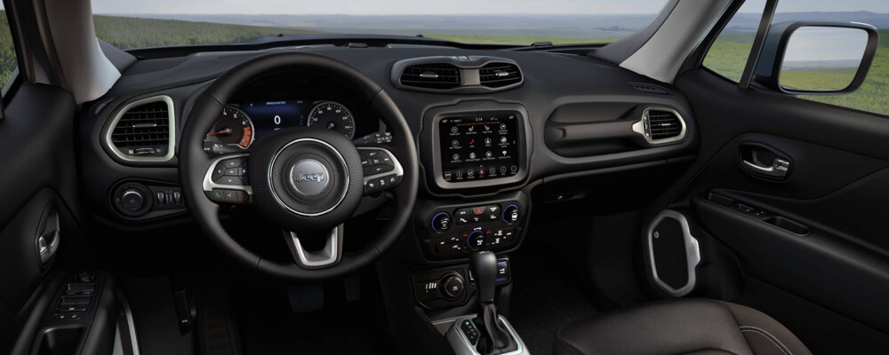
Jeep Renegade
Projects
DRW Housing
CTR Bezel
PSG Housing
Plug

Slide 16
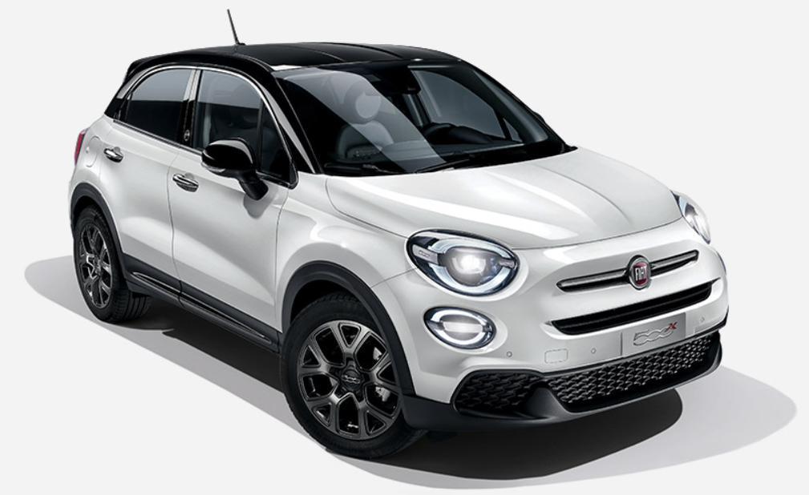
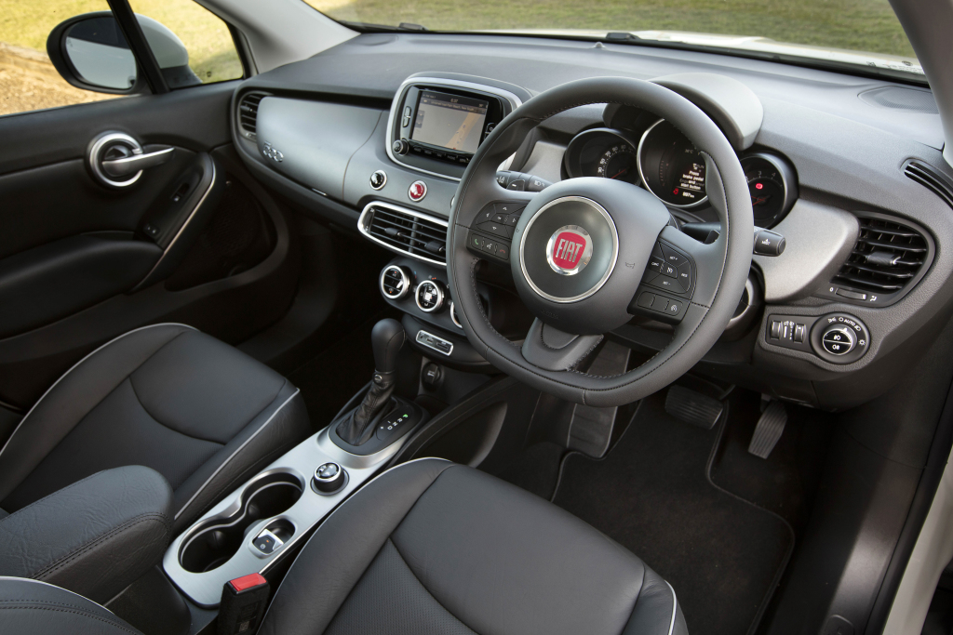
Fiat 500x
Projects
MOSTRINA USB/NON Bezel
MOSTRINA SPP Bezel

Slide 17
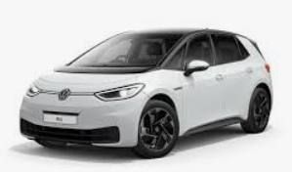
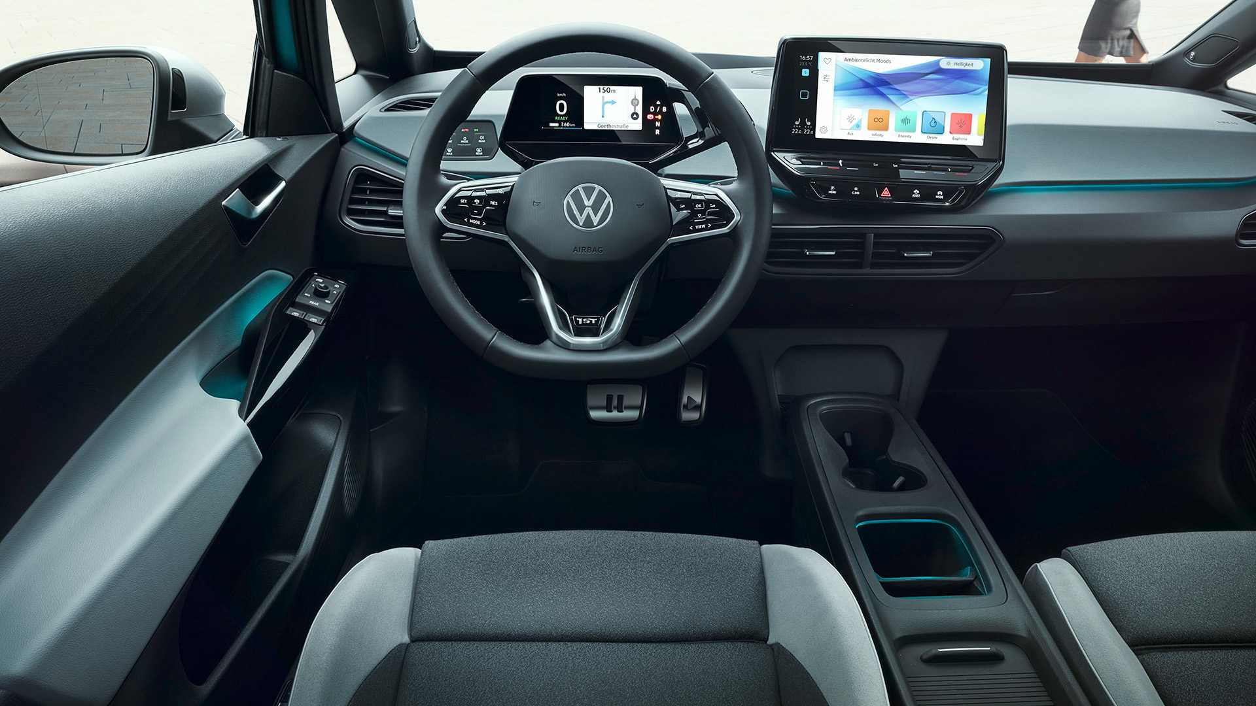
VW ID.3
Projects
Tester Kappe LHD/RHD

Slide 18
What we offer ?
STRONG and STABLE supplier
Go to Zero defect
highly trained staff
simply hierarchy for quick reaction and troubleshooting
offer effective and profitable solutions
production flexibility
very good location
growing possibility of production plants and warehouses
production processes according to ISO standards

Slide 19
Main Contacts
Company Owner
Mário Belák
belak@colortrack.sk
+421 908 763 855
Managing Director
Marian Stano
stano@colortrack.sk
+421 948133078
Sales Manager
Milan Pavlenko
pavlenko@colortrack.sk
+421 915 553 993

Slide 20
We Know What is the Paint...

Slide 21
THANK YOU...

